Slide 1
Individual Homework
Exercises Boolean functions
Berar denisa- 911

Slide 2
Exercise 4.1 Boolean Functions
Simplify the following Boolean functions of 4 variables using Veitch diagrams.

Slide 3
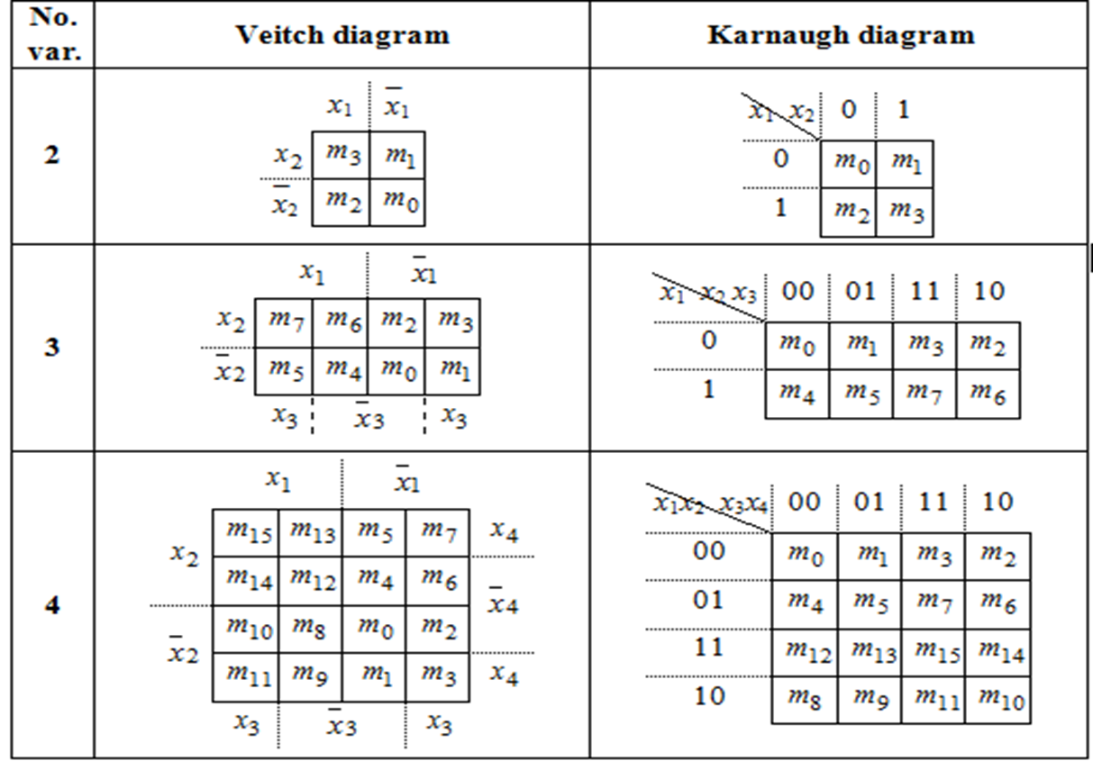

Slide 4
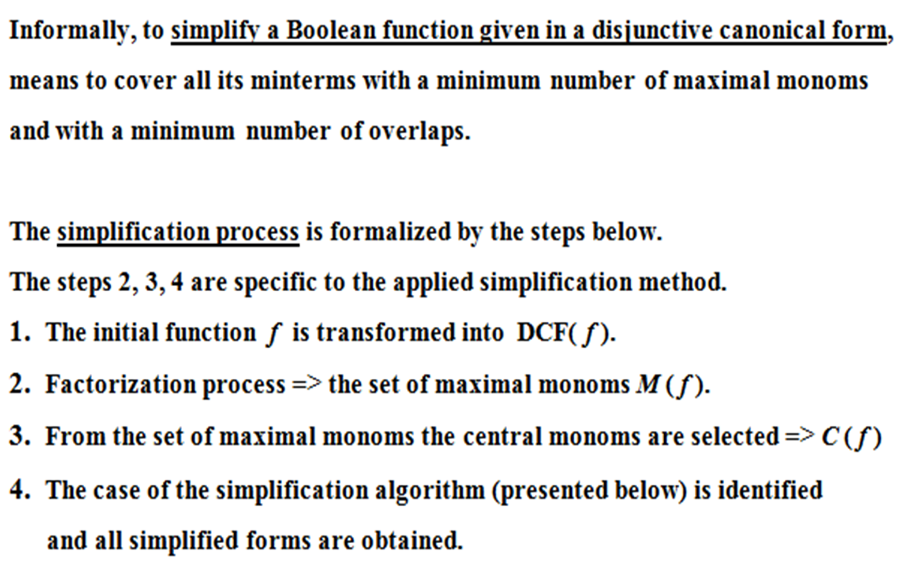
Simplification of Boolean Functions

Slide 5
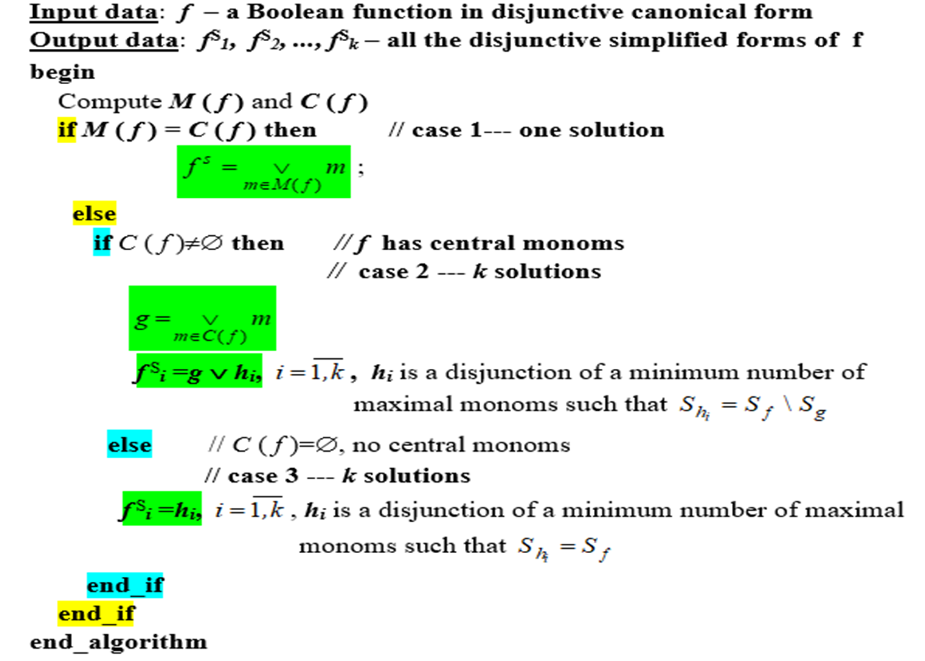

Slide 6
= x₁ x₂ x₃ x̄₄ ∨ x₁ x̄₂ x₃ x̄₄ ∨ x₁ x₂ x̄₃ x̄₄ ∨ x₁ x̄₂ x̄₃ x̄₄ ∨ x₁x₂ x̄₃x₄∨ x̄₁ x₂ x₃x₄ ∨ x̄₁ x₂ x̄₃x₄ ∨
x̄₁ x₂ x₃ x₄ ∨ x̄₁ x̄₂ x₃ x₄∨ x̄₁ x₂ x₃ x̄₄ ∨ x̄₁ x̄₂ x₃x̄₄ ∨ x₁ x₂ x₃ x̄₄ ∨ x₁ x̄₂ x₃ x̄₄ ∨ x̄₁ x₂ x₃ x̄₄ ∨ x̄₁ x̄₂ x₃ x̄₄
= m14 ∨ m10 ∨ m12 ∨ m8 ∨ m13 ∨ m7 ∨ m5 ∨ m7 ∨ m3 ∨ m6 ∨ m2 ∨ m14 ∨ m10 ∨ m6 ∨ m2
=m2 ∨ m3 ∨ m5 ∨ m6 ∨ m7 ∨ m8 ∨ m10 ∨ m12 ∨ m13 ∨ m14

Slide 7
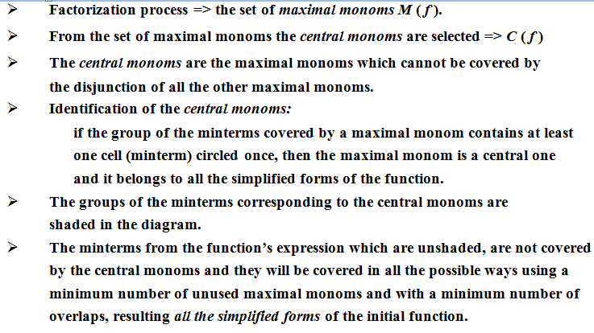

Slide 8
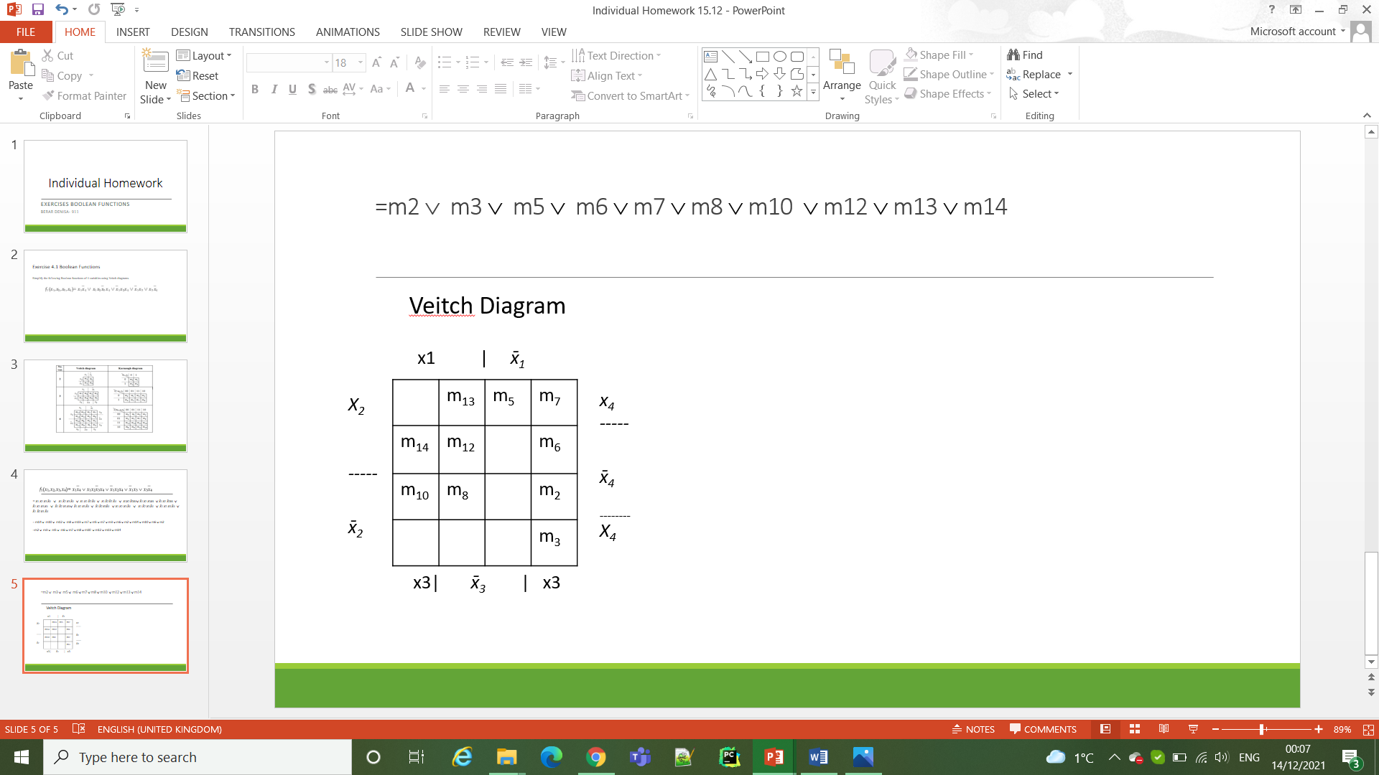
Factorization process
=m2 ∨ m3 ∨ m5 ∨ m6 ∨ m7 ∨ m8 ∨ m10 ∨ m12 ∨ m13 ∨ m14
Veitch Diagram
x1 | x̄₁
X₂
-----
x̄₂
 | m₁₃ | m₅ | m₇
m₁₄ | m₁₂ |  | m₆
m₁₀ | m₈ |  | m₂
 |  |  | m₃
x₄
-----
x̄₄
₋₋₋₋₋₋₋₋
X₄
x3| x̄₃ | x3
- 3 groups of 4 neighbour minterms
- 3 groups of 2 neighbours minterms

Slide 9
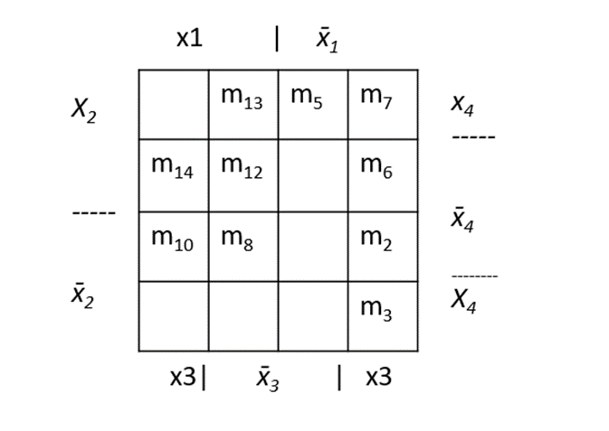

Factorization process
Double factorization
m7 ∨ m6 ∨ m2 ∨ m3 = x̄₁ ∨ x₃ = max1
Double factorization
m8 ∨ m10 ∨ m12 ∨ m14 = x₁ ∨ x̄₄ = max2
m6 ∨ m2 ∨ m14 ∨ m10 = x₃ ∨ x̄₄ = max3

Slide 10

Simple factorization
m7 ∨ m5 ∨ m13 = x̄₁ ∨ x₂ ∨ x₄ = max5
Simple factorization
m5 ∨ m13 = x₂ ∨ x̄₃ ∨ x₄ = max4
Simple factorization
m12 ∨ m13 = x₁∨ x₂ ∨ x̄₃ = max6

Slide 11
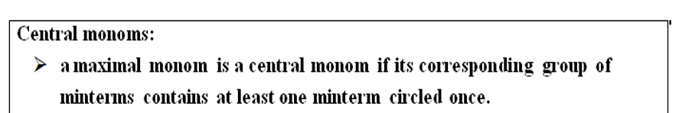
M(f) = {max1, max2, max3, max4, max 5, max6}
C(f) = {max1, max2} = {x̄₁ ∨ x₃ , x₁ ∨ x̄₄}
– the set of central monoms
The minterms coverred by the central monoms are shaded.
We denote g = max1 ∨ max2
The simplified form of f:
f1 ^{S}(x₁x₂x₃x₄) = g ∨ max4
f2 ^{S}(x₁x₂x₃x₄) = g ∨ max5 ∨ max6

Slide 12
Exercise 4.8 Boolean Functions
= x₁ x₂ x₃ x₄ ∨ x̄₁ x₂ x₃ x₄ ∨ x₁ x̄₂ x₃ x₄ ∨ x̄₁ x̄₂ x₃ x₄ ∨ x₁ x̄₂ x₃ x̄₄ ∨ x₁ x̄₂ x̄₃ x̄₄ ∨ x̄₁ x̄₂ x̄₃ x̄₄ ∨ x̄₁ x₂ x̄₃ x₄ ∨ x̄₁ x̄₂ x̄₃ x₄ ∨ x̄₁ x₂ x̄₃ x̄₄ ∨ x̄₁ x̄₂ x̄₃ x̄₄ ∨ x̄₁ x₂ x₃ x₄ ∨ x̄₁ x̄₂ x₃ x₄ ∨ x̄₁ x₂ x̄₃ x₄ ∨ x̄₁ x̄₂ x̄₃ x₄
x1 | x̄₁
X₂
-----
x̄₂
m₁₅ |  | m₅ | m₇
 |  | m₄
m10 | m₈ | m₀
m₁₁ |  | m₁ | m₃
x₄
-----
x̄₄
₋₋₋₋₋₋₋₋
X₄
= m15 ∨ m7 ∨ m11 ∨ m3 ∨ m10 ∨ m8 ∨ m0 ∨ m5 ∨ m1 ∨ m4 ∨ m0 ∨ m7 ∨ m3 ∨ m5 ∨ m1
= m0 ∨ m1 ∨ m3 ∨ m4 ∨m5 ∨ 7 ∨ m8 ∨ m11 ∨ m15 ∨ m10
x3| x̄₃ | x3

Slide 13
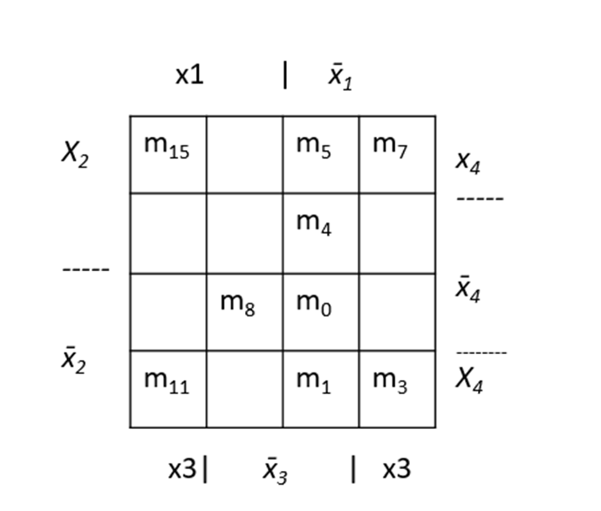

Factorization process
Double Factorization:
m3 ∨ m7 ∨ m11 ∨ m15 =x₃ x₄ = max1
m1 ∨ m0 ∨ m4 ∨ m5 = x̄₁ x̄₃ = max2
m1 ∨ m3∨ m5 ∨ m7 = x̄₁ x₄ = max3
Simple factorization:
m0 ∨ m8 = x̄₂x̄₃x̄₄ = max4
m1 ∨ m3 = x̄₁ x̄₂ x₄ = max5
m5 ∨ m7 = x̄₁ x₂ x₄ = max6
m10 ∨ m11 = x₁x̄₂x₃ =max 7
m10 ∨ m8 = x₁x̄₂x₄ = max 8
m10
- 3 groups of 4 neighbour minterms(max1, max2, max3)
- 5 groups of 2 neighbours minterms(max4, max5, max6, max7,max8)
The set of maximal monoms:
M(f) = {max1, max2,max3,max4, max5, max6, max7, max8}

Slide 14

M(f) = {max1, max2,max3,max4, max 5, max6}
C(f) = {max1, max2, max3} = {x₃ x₄ , x̄₁ x̄_{3 ,} x̄₂x̄₃x̄₄ } – the set of central monoms
m10
The minterms coverred by the central monoms are shaded.
We denote g = max1 ∨ max2
The simplified form of f:
f1 ^{S}(x₁x₂x₃x₄) = g ∨ max8
f2 ^{S}(x₁x₂x₃x₄) = g ∨ max7 ∨ max4
m0 ∨ m8 = x̄₂x̄₃x̄₄ = max4
m10 ∨ m11 = max 7
m10 ∨ m8 = max 8

